Slide 1
Amazon Music Clustering Using Machine Learning
Audio Feature-Based Unsupervised Learning Project

Slide 2
Problem Statement
Cluster Amazon music tracks using audio features
Identify natural groups of songs
Analyze song characteristics for insights
Compare clustering algorithms (K-Means, DBSCAN)

Slide 3
Dataset Overview
~90,000+ tracks
10 audio features used
Examples: danceability, energy, loudness, tempo, valence
All numeric suitable for ML
Dataset cleaned & standardized

Slide 4
Data Preprocessing
Removed text columns (song name, artist)
Checked for missing values
Standardized numeric features using StandardScaler
Applied PCA for visualization (2 components)

Slide 5
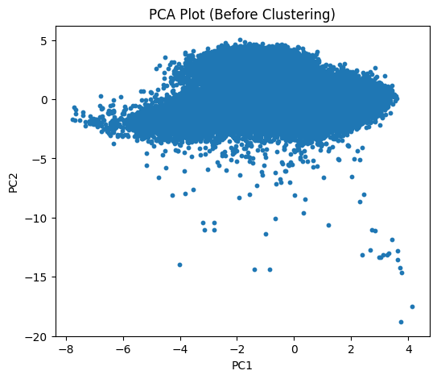
PCA Before Clustering

Slide 6
Insights for PCA Before Clustering
PCA reduces 10 audio features into 2 components for visualization.
Songs from one large dense group – no clear natural clusters yet.
Several points are far away – outliers exist in the dataset.
Data spread shows high variation in audio features (energy, loudness, tempo).
Clustering is needed to uncover hidden structure in the data.

Slide 7
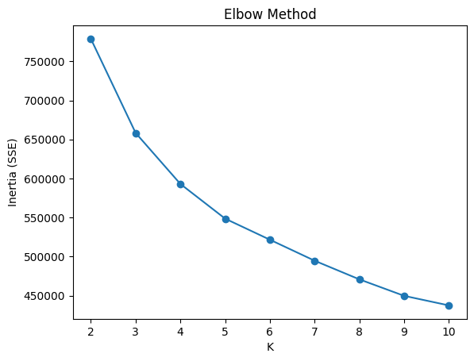
Elbow Method

Slide 8
Insights For Elbow Method
SSE drops sharply until K = 3, then levels off.
Indicates 3 clusters is the optimal choice.
Using more than 3 clusters gives minimal improvement.
Elbow method supports selecting K=3 for K-Means.

Slide 9
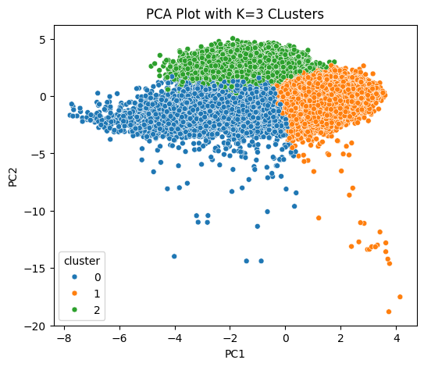
K-Means Clustering

Slide 10
Insights For K-Means Clustering
Three clear, well separated clusters appear in PCA space.
Clusters have distinct boundaries with minimal overlap.
K-Means successfully groups similar songs together.
Visualization confirms K=3 is a meaningful structure.

Slide 11
Interpretation of Clusters
Cluster 0 Acoustic/Calm | Cluster 1 Pop/Dance | Cluster 2 Rap/Hip-Hop
High acousticness | High energy | Very high speechiness
Low energy | High danceability | Shorter duration
Softer loudness | Positive valence | High livenss

Slide 12
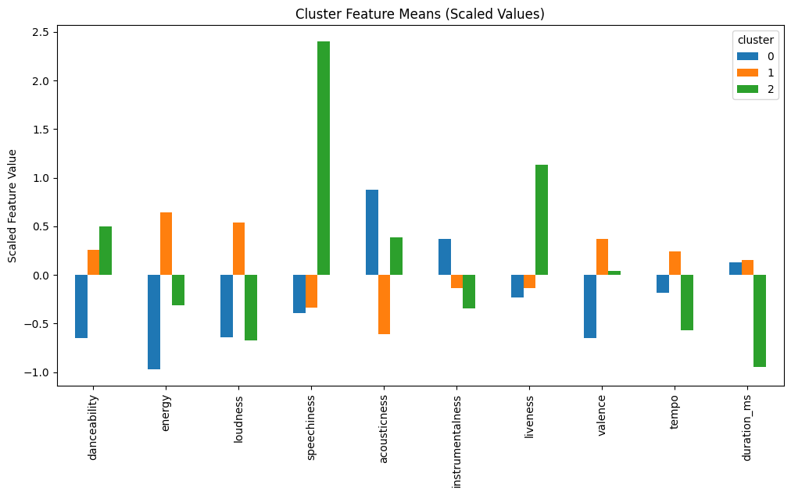
Scaled Feature Means

Slide 13
Insights For Scaled Feature Means
Cluster 0 – More acoustic, low energy, calm tracks.
Cluster 1 – High energy & danceability; upbeat/pop songs.
Cluster 2 – Very high speechiness; rap/spoken word style music.
Feature differences confirm that K=3 clusters are meaningful.

Slide 14
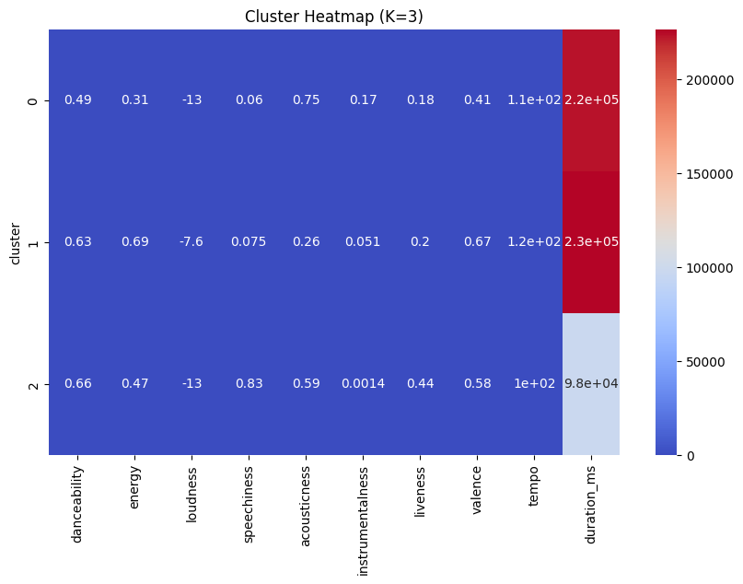
Heatmap of Cluster Means

Slide 15
Insights For Cluster Heatmap
Heatmap highlights which features define each cluster.
Cluster 1 shows highest energy & tempo – energetic tracks.
Cluster 2 shows highest speechiness – rap/hip-hop patterns.
Cluster 0 has high acousticness – calm/acoustic songs.
Strong feature separation proves clusters are well-formed.

Slide 16
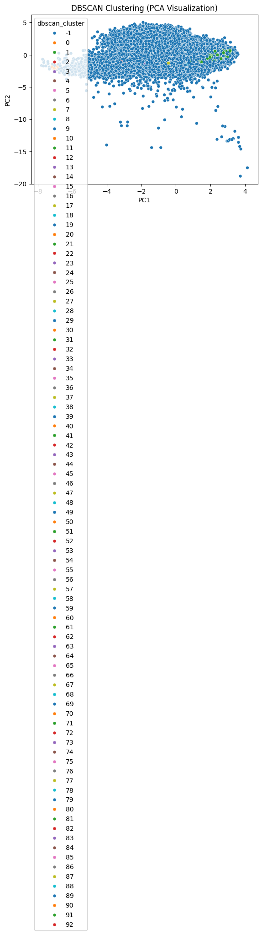
DBSCAN PCA Visualization

Slide 17
Insights for DBSCAN PCA Visualization
DBSCAN created many tiny clusters, each with very few songs.
Majority of points are labeled noise, showing poor separation.
Confirms that density-based clustering is not suitable for this dataset.
K-Means performs much better than DBSCAN.

Slide 18
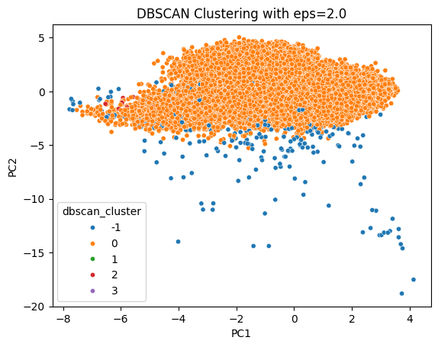
DBSCAN (eps=2.0)

Slide 19
Insights For DBSCAN (eps=2.0)
DBSCAN forms one major cluster and several noise points.
Many songs are marked as outliers (-1)
The dataset is too high dimensional for DBSCAN to cluster effectively.
DBSCAN is useful for detecting unusual or rare tracks, not grouping genres.

Slide 20
DBSCAN vs K-Means Comparison
K-Means | DBSCAN
Forms clear, well-separated clusters. | Produces many noise points and tiny clusters.
Works well on large, high-dimensional numeric data. | Does not handle high-dimensional audio features effectively.
Provides stable cluster assignments. | Only good for detecting outliers, not meaningful music group.

Slide 21
Comparison Summary
K-Means = Best overall clustering method for music features.
DBSCAN = Good for outlier detection, not grouping genres.
PCA visualizations clearly show K-Means structure is stronger.

Slide 22
Project Summary
Applied PCA and clustering on Amazon Music audio features.
Identified 3 meaningful clusters representing different musical styles.
K-Means produced clear and interpretable groups.
DBSCAN mainly identified outliers tracks, not strong clusters.

Slide 23
Key Findings
Clusters differ strongly in energy, acousticness, speechiness, tempo, etc.
Feature analysis confirms distinct music categories.
K-Means is the most effective algorithm for this dataset.

